Slide 1
Chapter 11
I/O Management and Disk Scheduling

Slide 2
Categories of I/O Devices
Human readable
For communicating with the user
Examples: printers, terminals, video display, keyboard, mouse
Machine readable
For communicating with electronic equipment
Examples: disk drives, USB keys, sensors, controllers

Slide 3
Categories of I/O Devices
Communication
For communicating with remote devices
Example: modem, digital line drivers

Slide 4
Differences in I/O Devices
Data rate: may be differences of magnitude between the data transfer rates

Slide 5
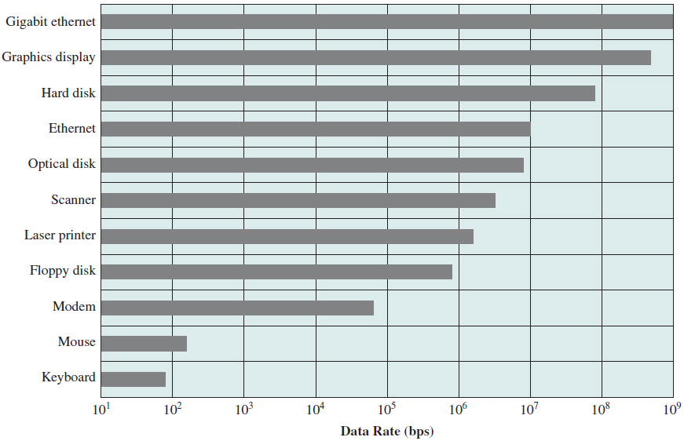
Differences in I/O Devices

Slide 6
Differences in I/O Devices
Application: has an influence on the software and policies in the OS and supporting utilities. Examples:
Disk used to store files requires file management software
Disk used to store virtual memory pages needs special hardware and software to support it
Terminal used by system administrator may have a higher priority

Slide 7
Differences in I/O Devices
Complexity of control: the effect on the OS is filtered by the complexity of the I/O module that controls the device. Examples:
Printer – simple control interface
Disk – complex control interface
Unit of transfer
Data may be transferred as a stream of bytes (e.g. terminal I/O) or in larger blocks (e.g. disk I/O)

Slide 8
Differences in I/O Devices
Data representation
Different data encoding schemes are used by different devices
Error conditions
the nature of errors, the way in which they are reported, their consequences, and the available range of responses differs from one device to another

Slide 9
I/O Functions
3 techniques for performing I/O
Programmed I/O
processor issues an I/O command on behalf of a process to an I/O module; that process then busy waits for the operation to be completed before proceeding
Interrupt-driven I/O
processor issues an I/O command on behalf of a process
if blocking – OS will put the current process in a blocked state
Notes:
AST

Slide 10
I/O Functions
3 techniques for performing I/O
Direct Memory Access (DMA)
DMA module controls the exchange of data between main memory and an I/O module
Notes:
AST

Slide 11
I/O Techniques
 | No Interrupts | Use of Interrupts
I/O-to-memory transfer through processor | Programmed I/O | Interrupt-driven I/O
Direct I/O-to-memory transfer |  | Direct memory access (DMA)

Slide 12
Evolution of the I/O Function
Processor directly controls a peripheral device
Controller or I/O module is added
Processor uses programmed I/O without interrupts
Processor does not need to handle details of external devices
Controller or I/O module with interrupts
Processor does not spend time waiting for an I/O operation to be performed

Slide 13
Evolution of the I/O Function
Direct Memory Access
Blocks of data are moved into memory without involving the processor except at the beginning and end of transfer

Slide 14
Evolution of the I/O Function
I/O module is a separate processor
CPU directs the I/O processor to execute an I/O program in main memory
processor able to specify a sequence of I/O activities and to be interrupted only when the entire sequence has been performed.
I/O processor
I/O module has its own local memory
Its a computer in its own right

Slide 15
Direct Memory Access
Processor delegates I/O operation to the DMA module, with the following information provided
Read or write request
Address of I/O device
Starting location in memory to read from / write to
Number of words to read / write
DMA module transfers data directly to or from memory

Slide 16
Direct Memory Access
When complete, DMA module sends an interrupt signal to the processor

Slide 17
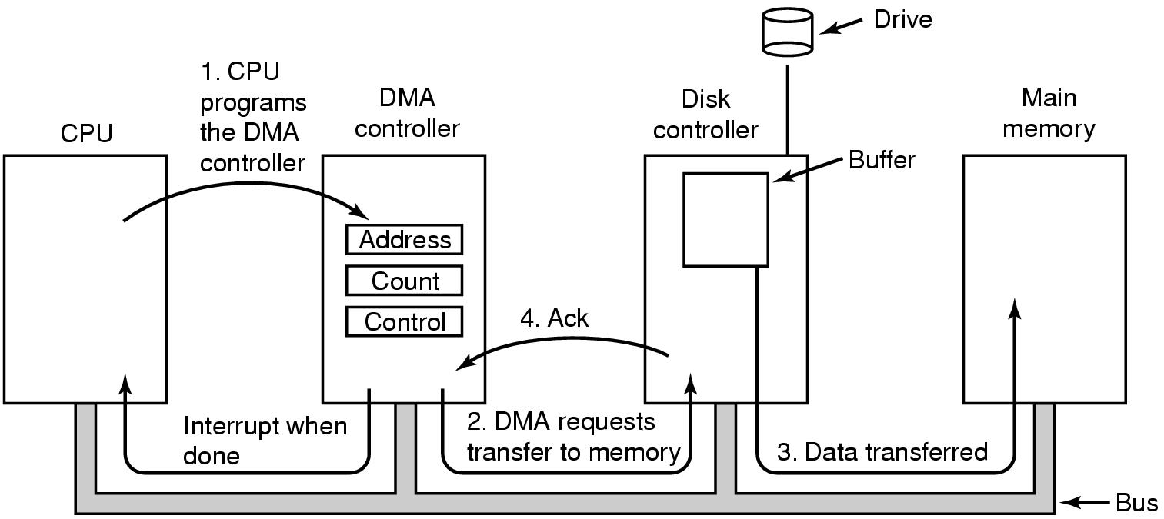
Direct Memory Access
Step 1: information are written to controller’s registers (memory address register, byte count register, control register(s)).
Notes:
AST

Slide 18
Direct Memory Access
Step 2: DMA issues read request to the disk controller.
Notes:
AST

Slide 19
Direct Memory Access
Step 3: disk controller write the data stored in internal buffer to memory
Notes:
AST

Slide 20
Direct Memory Access
Step 4: disk controller sends acknowledgement signal to DMA controller
Notes:
AST

Slide 21
Direct Memory Access
DMA controller increments the memory address to use and decrements the byte count.
Steps 2 – 4 are repeated until the byte count reaches 0 and the DMA controller will interrupts the CPU.
Notes:
AST

Slide 22
Operating System Design Issues
Design objectives: Efficiency and Generality
Efficiency
Important because I/O operations often form a bottleneck
Most I/O devices are extremely slow compared with main memory and the processor
Multiprogramming allows some processes to be waiting on I/O operations while another process is executing
Swapping is used to bring in additional ready processes to keep the processor busy, but this in itself is an I/O operation

Slide 23
Operating System Design Issues
Generality
Desirable to handle all I/O devices in a uniform manner
Applies to the way processes view I/O devices and the way the OS manages I/O devices and operations
Hide most of the details of device I/O in lower-level routines so that processes and upper levels see devices in general terms such as read, write, open, close, lock, unlock

Slide 24
Operating System Design Issues
Generality
Use a hierarchical, modular approach to the design of the I/O function
Hide most of the details of device I/O in lower-level routines so that processes and upper levels see devices in general terms such as read, write, open, close, lock and unlock

Slide 25
Logical Structure of I/O Function
Local peripheral device (communicates in stream of bytes or records) involves a few layers
Logical I/O
Device I/O
Scheduling & control
Scheduling & control
Device I/O
Logical I/O
User processes
Hardware

Slide 26
Logical Structure of I/O Function
Local peripheral device
Logical I/O
Logical I/O module deals with the device as a logical resource and is not concerned with the details of actually controlling the device.
Manage general I/O functions on behalf of user processes, allowing them to deal with the device in terms of a device identifier and simple commands such as open, close, read, and write.

Slide 27
Logical Structure of I/O Function
Local peripheral device
Device I/O
Requested operations and data are converted into sequences of I/O instructions, channel commands, and controller orders.
Schedule and Control
The actual queuing and scheduling of I/O operations, control of operations. Interrupts are handled at this layer and I/O status is collected and reported.
The layer that actually interacts with the I/O module

Slide 28
Logical Structure of I/O Function
Communication device
logical I/O module is replaced by a communications architecture, example TCP/IP
Scheduling & control
Device I/O
Communication architecture
User processes
Hardware

Slide 29
Logical Structure of I/O Function
File system device – three different layers
Directory management
symbolic file names (link) are converted to identifiers that either reference the file directly or indirectly through a file descriptor or index table
Scheduling & control
Device I/O
Physical organisation
File system
Hardware
User processes
Directory management

Slide 30
Logical Structure of I/O Function
File system device – three different layers
File system
Deal with the logical structure of files and with the operations such as open, close, read, and write.
Manage access rights
Physical organization
Convert logical references to files and records to physical secondary storage addresses
Allocate secondary storage space and main storage buffers

Slide 31
Buffering
Buffering: perform input transfers in advance and perform output transfers some time after the request - efficiency
Block-oriented device
Stores information in blocks that are usually of fixed size
Transfers are made one block at a time
Possible to reference data by its block number
Examples: disks and USB keys

Slide 32
Buffering
Stream-oriented device
Transfers data as a stream of bytes
Examples: terminals, printers, communications ports, and most other devices that are not secondary storage

Slide 33
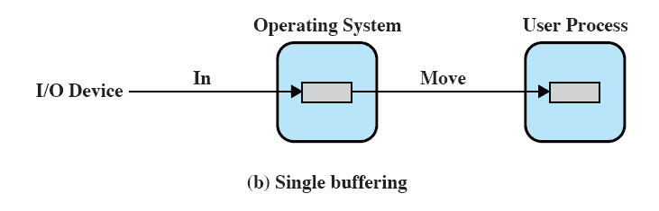
Single Buffer
OS assigns a buffer in main memory for an I/O request

Slide 34
Single Buffer
Block-oriented
Reading ahead/anticipated input
is done in the expectation that the block will eventually be needed
when the transfer is complete, the process moves the block into user space and immediately requests another block

Slide 35
Single Buffer
Stream-oriented
Line-at-a-time operation
user input is one line at a time with a carriage return signaling the end of a line
output to the terminal is one line at a time
Examples: dumb terminals, line printer
Byte-at-a-time operation
used when each keystroke is significant
Examples: sensors and controllers

Slide 36
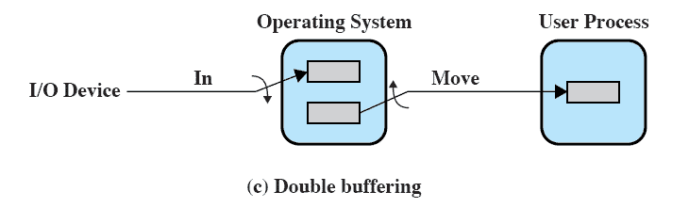
Double Buffer
A process can transfer data to or from one buffer while the operating system empties or fills the other buffer
Also known as buffer swapping

Slide 37
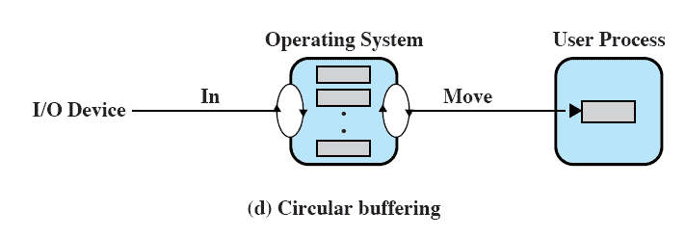
Circular Buffer
Each individual buffer is one unit in a circular buffer
Used when I/O operation must keep up with process

Slide 38
Disk Performance Parameters
Disk is rotating at constant speed
To read or write, the disk head must be positioned at the desired track and at the beginning of the desired sector
Seek time
Time it takes to position the head at the desired track
Rotational delay or rotational latency
Time its takes for the beginning of the sector to reach the head

Slide 39
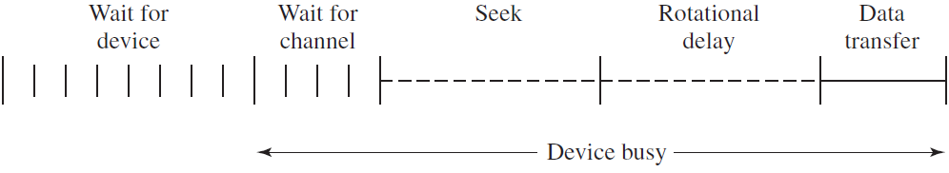
Disk Performance Parameters
Access time
Sum of seek time and rotational delay
The time it takes to get in position to read or write

Slide 40
Disk Scheduling Policies
Seek time is the reason for differences in performance
For a single disk there will be a number of I/O requests, if requests are selected randomly, giving poor performance

Slide 41
Disk Scheduling Policies
Requested tracks: 55, 58, 39, 18, 90, 160, 150, 38, 184
First-in, first-out (FIFO)
Process request sequentially
Fair to all processes
Approaches random scheduling in performance if there are many processes

Slide 42
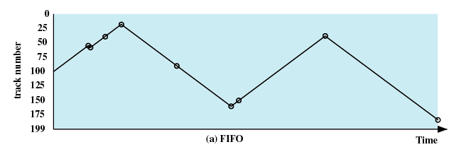
Disk Scheduling Policies
Requested tracks: 55, 58, 39, 18, 90, 160, 150, 38, 184
FIFO
(starting at track 100)
Next track accessed | Number of tracks traversed
55 | 45
58 | 3
39 | 19
18 | 21
90 | 72
160 | 70
150 | 10
38 | 112
184 | 146
Average seek length | 55.3

Slide 43
Disk Scheduling Policies
Requested tracks: 55, 58, 39, 18, 90, 160, 150, 38, 184
Shortest Service Time First
Select the disk I/O request that requires the least movement of the disk arm from its current position
Always choose the minimum Seek time

Slide 44
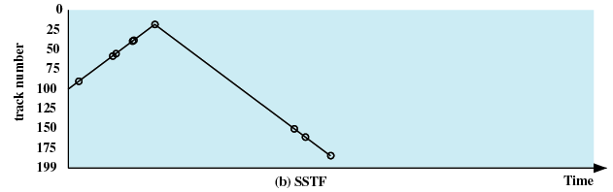
Disk Scheduling Policies
Requested tracks: 55, 58, 39, 18, 90, 160, 150, 38, 184
SSTF
(starting at track 100)
Next track accessed | Number of tracks traversed
90 | 10
58 | 32
55 | 3
39 | 16
38 | 1
18 | 20
150 | 132
160 | 10
184 | 24
Average seek length | 27.5

Slide 45
Disk Scheduling Policies
Requested tracks: 55, 58, 39, 18, 90, 160, 150, 38, 184
SCAN
Also known as the elevator algorithm
Arm moves in one direction only, satisfies all outstanding requests until it reaches the last track in that direction then the direction is reversed

Slide 46
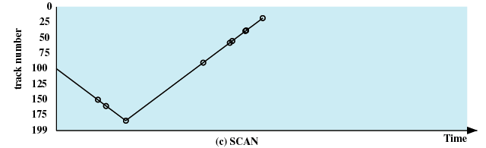
Disk Scheduling Policies
Requested tracks: 55, 58, 39, 18, 90, 160, 150, 38, 184
SCAN
(starting at track 100, in the direction of increasing track number)
Next track accessed | Number of tracks traversed
150 | 50
160 | 10
184 | 24
90 | 94
58 | 32
55 | 3
39 | 16
38 | 1
18 | 20
Average seek length | 27.8

Slide 47
Disk Scheduling Policies
Requested tracks: 55, 58, 39, 18, 90, 160, 150, 38, 184
C-SCAN (Circular SCAN)
Restricts scanning to one direction only
When the last track has been visited in one direction, the arm is returned to the opposite end of the disk and the scan begins again

Slide 48
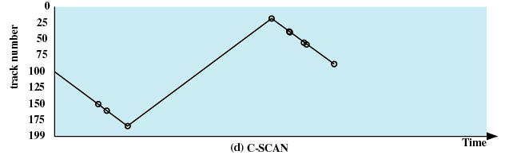
Disk Scheduling Policies
Requested tracks: 55, 58, 39, 18, 90, 160, 150, 38, 184
C-SCAN
(starting at track 100, in the direction of increasing track number)
Next track accessed | Number of tracks traversed
150 | 50
160 | 10
184 | 24
18 | 166
38 | 20
39 | 1
55 | 16
58 | 3
90 | 32
Average seek length | 35.8

Slide 49
Disk Scheduling Policies
N-step-SCAN
Segments the disk request queue into subqueues of length N
Subqueues are processed one at a time, using SCAN
New requests added to other queue when a queue is being processed
If fewer than N requests are available at the end of a scan, all of them are processed with the next scan

Slide 50
Disk Scheduling Policies
F-SCAN
Uses two subqueues
When a scan begins, all of the requests are in one of the queues, with the other empty
During scan, all new requests are put into the other queue
Service of new requests is deferred until all of the old requests have been processed

Slide 51
Disk Cache
Buffer in main memory for disk sectors
Contains a copy of some of the sectors on the disk
when an I/O request is made for a particular sector, a check is made to determine if the sector is in the disk cache
if YES
the request is satisfied via the cache
if NO
the requested sector is read into the disk cache from the disk

Slide 52
Replacement - Least Recently Used
Most commonly used algorithm that deals with the design issue of replacement strategy
The block that has been in the cache the longest with no reference to it is replaced
A stack of pointers reference the cache
Most recently referenced block is on the top of the stack
When a block is referenced or brought into the cache, it is placed on the top of the stack

Slide 53
Replacement - Least Recently Used
The block on the bottom of the stack is removed when a new block is brought in
Blocks don’t actually move around in main memory
A stack of pointers is used

Slide 54
Replacement - Least Frequently Used
The block that has experienced the fewest references is replaced
A counter is associated with each block
Counter is incremented each time block accessed
Block with smallest count is selected for replacement

Slide 55
Replacement - Least Frequently Used
Problem: some blocks may be referenced many times in a short period of time and the reference count is misleading
To overcome: Frequency-based replacement

Slide 56
Replacement – Frequency-based
Overcome problem in Least Frequently Used
Blocks are logically organized in a stack
certain portion of the top part of the stack is designated the new section.
On cache hit, the referenced block is moved to the top of the stack
If the block was already in the new section, reference count is not incremented, otherwise it is incremented by 1

Slide 57
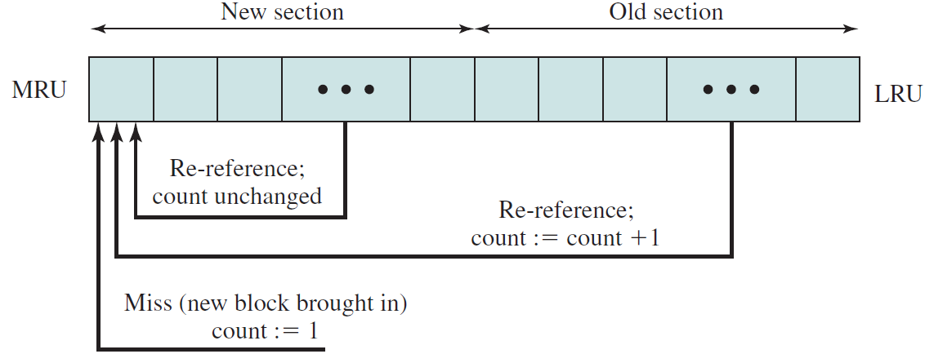
Replacement – Frequency-based
On a miss, the block with the smallest reference count that is not in the new section is chosen for replacement
In the event of a tie, the least recently used block is chosen.

Slide 58
Replacement – Frequency-based
Problem with frequency-based:
The count remains at 1 as long as the block remains in the new section
Eventually the block ages out of the new section, with its count still at 1
Insufficient long interval to build up reference counts, the block is very likely to be replaced

Slide 59
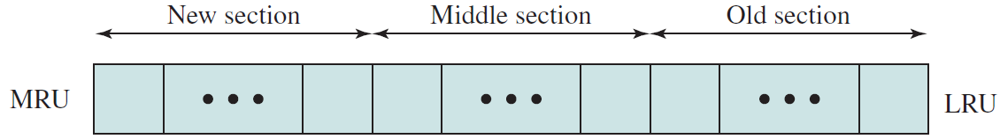
Replacement – Frequency-based
Refined policy, the stack is divided into three sections: new, middle, and old
Reference counts are not incremented on blocks in the new section.
Only blocks in the old section are eligible for replacement.

